Slide 1

Budget manager (using APPIUM TOOL)
KONKA VISHNU VARDHAN
192011391
CSE.

Slide 2

Project includes:
•Objective
•Abstract
•Proposed System
•Flow chart
•Concept map
•No of Test Cases
•Apps and Tools Installation
•Appium Server
•Implementing Testing
•Test Case Outcomes
•Conclusion

Slide 3

Objective :
•To Test the different strategies (Test Cases) on Unit Converter Application.
•To find all possible Outcomes (Positive and Negative) of the Test.

Slide 4

Abstract :
This monitors your own costs, family costs and incidental costs.
This resembles a present day costs day book in your versatile.
This application helps you to monitor your everyday costs, settlement points of interest, general rundown, report in detail and periodic costs subtle elements.

Slide 5
Proposed work
Test cases like App Launch , Performance , Profits and revenues will be Tested.
Testing is done using Appium Software.
To test First Install Android Studio , IntelliJ and Appium Software.
Develop Budget Manager Application in Android Studio.
Run the Application using Android Studio Emulator.
Then find the Positive and Negative outcomes of Testing.

Slide 6
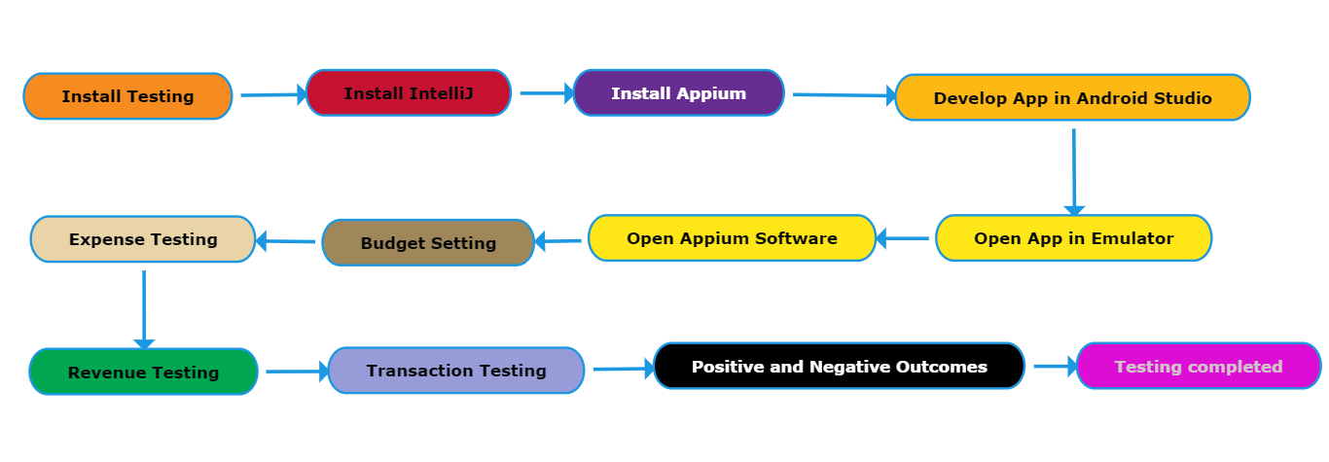
FLOW CHART :

Slide 7
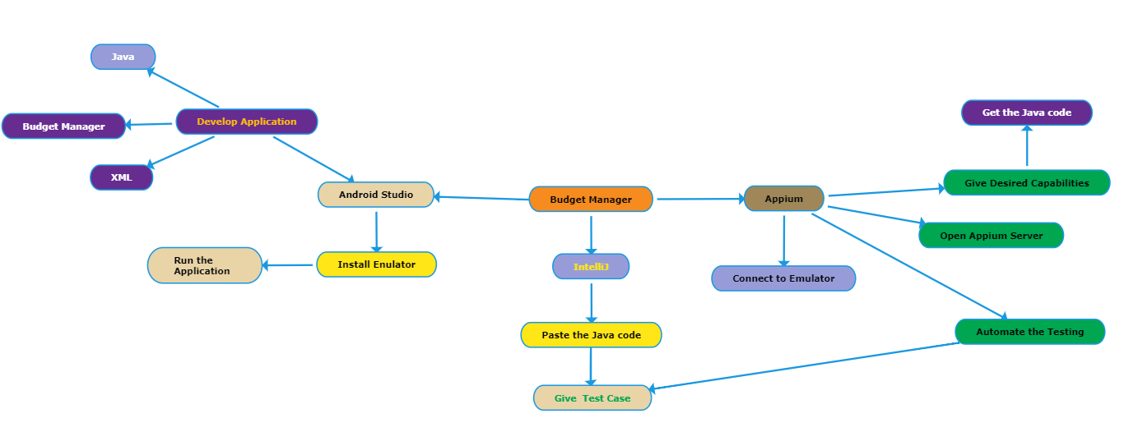
CONCEPT MAP :

Slide 8

NO OF TEST CASES:
App Launch.
Budget manager.
Transactions.
Setting of date.
Checking performance.
Receipt uploading.
Adding more budgets.

Slide 9



APPLICATIONS USED :

Slide 10
APPS AND TOOLS (APPIUM & ANDROID STUDIO)
•Appium
1.Open source Automation tool.
2.It is also a Automation Framework.
3.Automates different types of mobile applications testing.
4.It can test web , Native and Hybrid application.
5.It supports multiple programming languages. (Java , python , ruby and many more )
6.It works on Emulator as well as Real Devices.
Android Studio
1.It is Integrated development Environment.
2.It has fast Emulator for App Testing.
3.Used to Develop applications for Android devices.
4.It is an open source software.

Slide 11
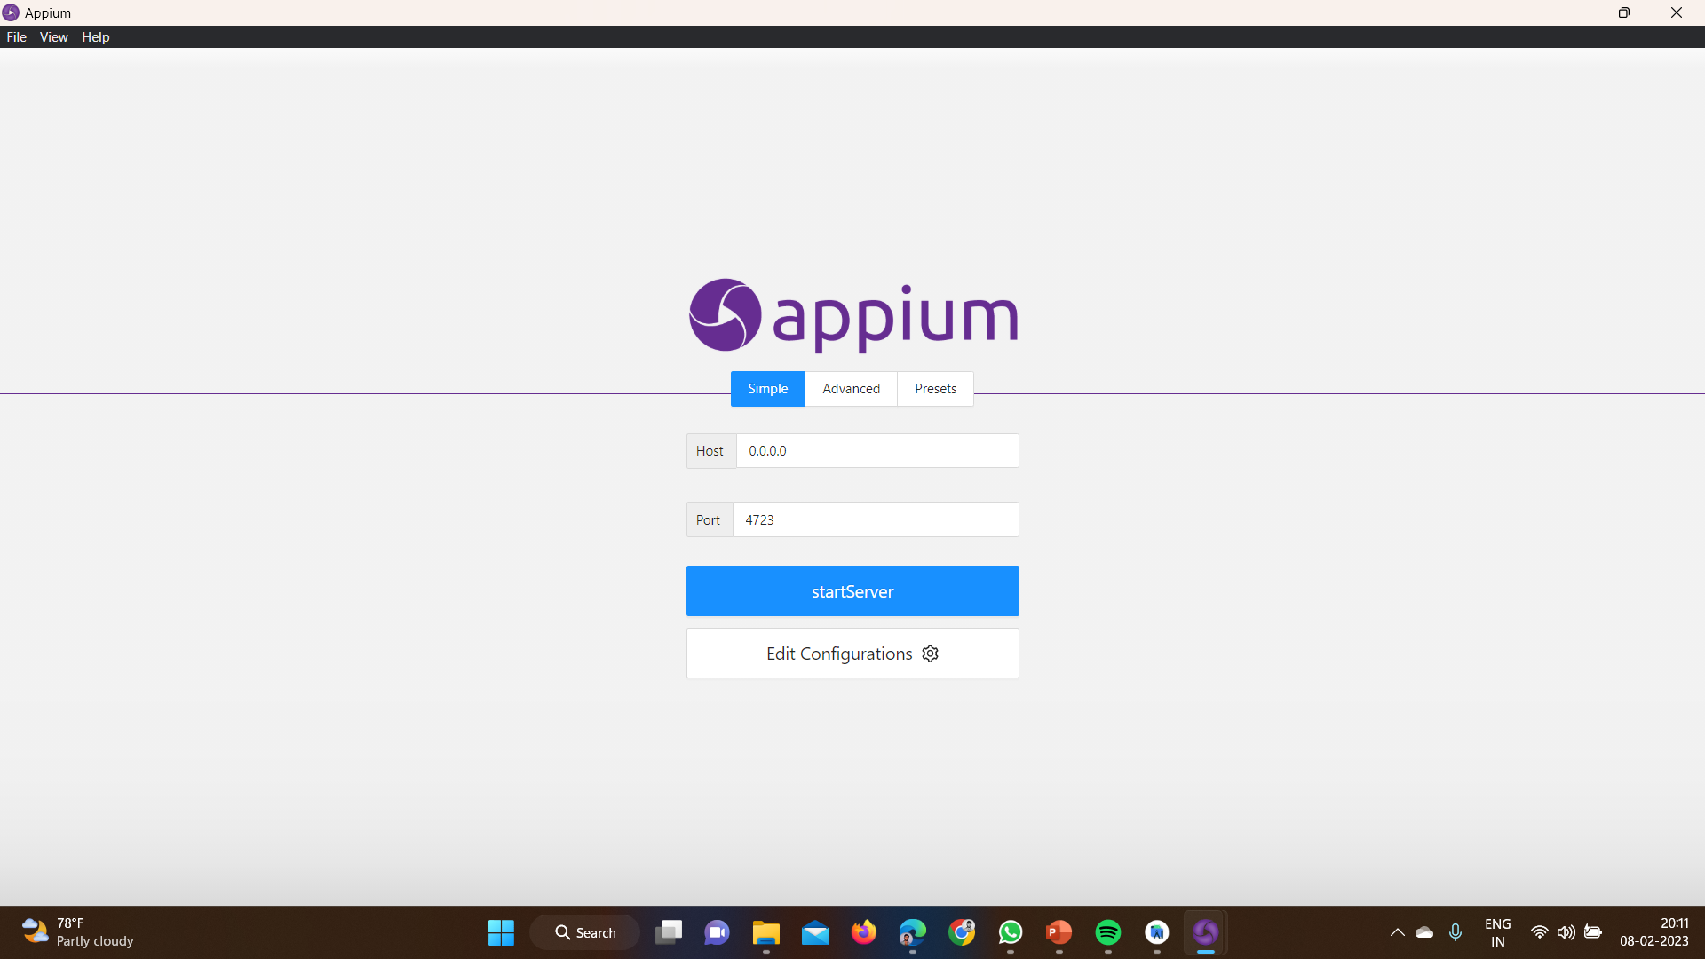
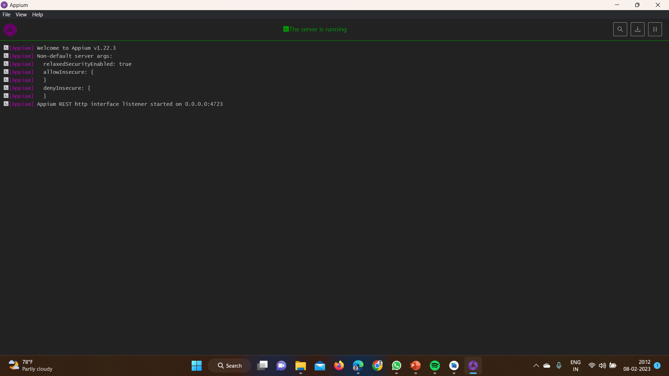
Appium Server :

Slide 12
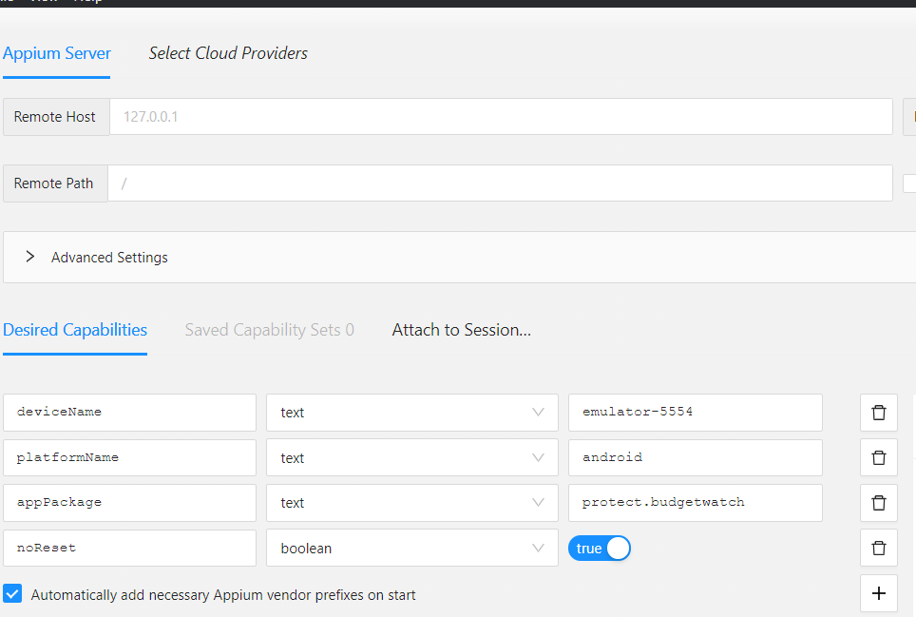
Setting Desired Capabilities in Appium Inspector :
•Give the Desired Capabilities in Appium Inspector.
•It will start the session and gives you java code to start testing.
•Paste the code in IntelliJ IDE and Start the Testing.

Slide 13
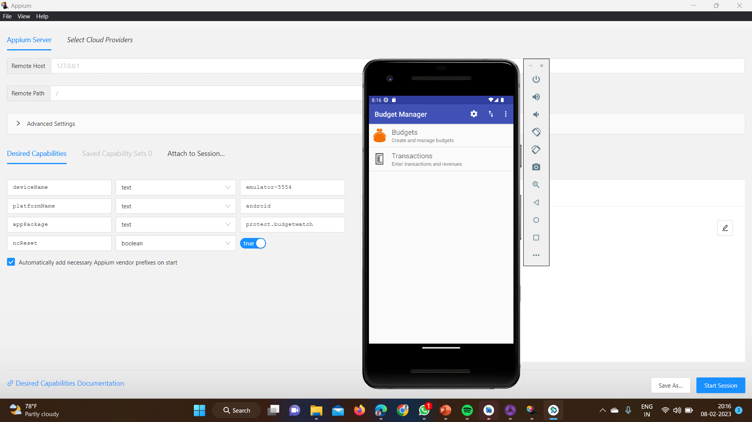
Implementation and Testing :

Slide 14
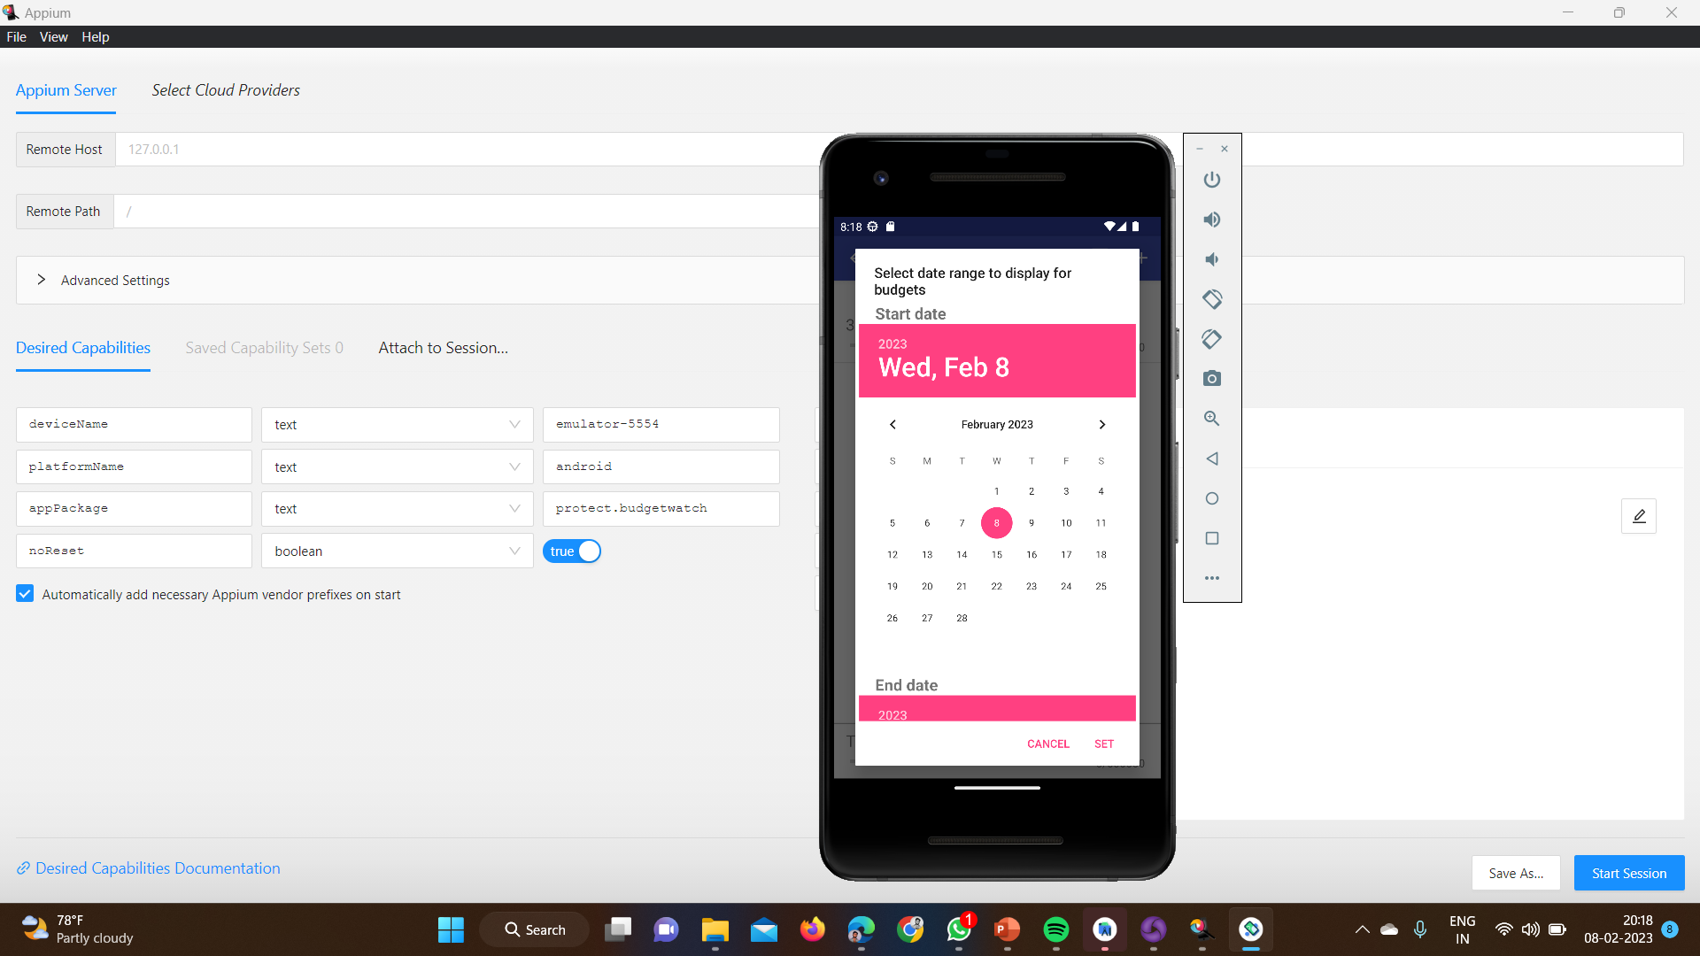
Implementation and Testing :

Slide 15
TEST CASE OUTCOMES :
1.verify the application launch in emulator | positive
2.check whether the transactions is visible | positive
3.check whether budget plan is visible | positive
4.test the calendar to set the date | positive
5.verify the performance of the application | positive
6.verify the add budget option | positive
7. verify the receipt or bill uploading option | negative
8.verify the overall efficiency | positive

Slide 16
CONCLUSION :
Using the Verification and Validation, testing of Application is done.
90% of the test cases were positive.
10% of the test cases were negative.

